Slide 1
Conceptual Understanding Series for West Virginia Teachers
Igneous Rocks
ED-17 Figures

Slide 2
Figure 1

Slide 3
Figure 1

Slide 4
Figure 2

Slide 5
Figure 4

Slide 6
Figure 5

Slide 7
Figure 6

Slide 8
Figure 7

Slide 9
Figure 8

Slide 10
Figure 9

Slide 11
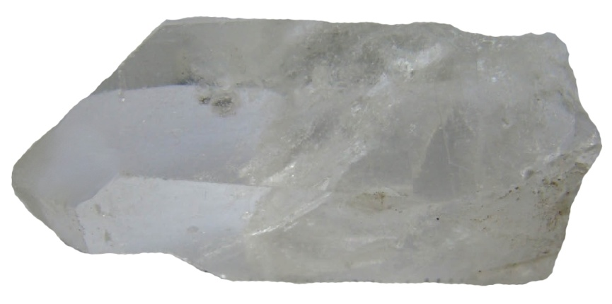
Figure 10A and B

Slide 12
Figure 11

Slide 13
Figure 12

Slide 14
Figure 13

Slide 15
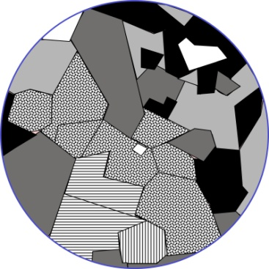
Figure 14A, B, C, D. and E

Slide 16
Figure 15

Slide 17
Figure 16

Slide 18
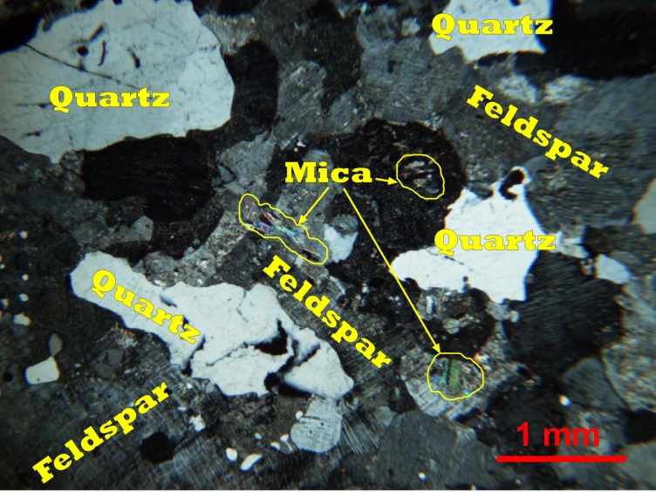
Figure 17a, b

Slide 19
Figure 18

Slide 20
Figure 19

Slide 21
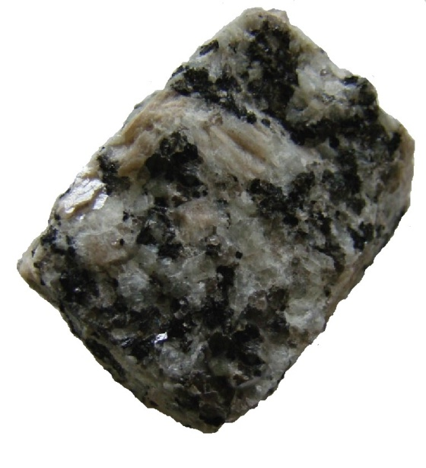
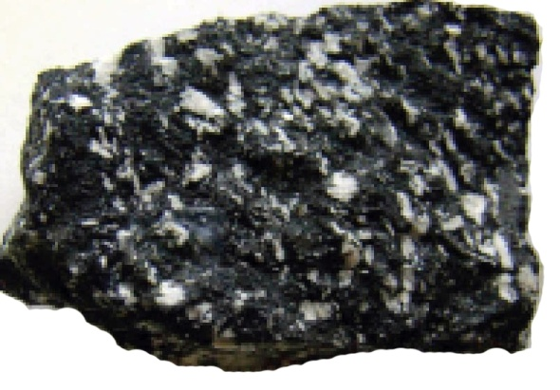
Figure 20, 21, and 22

Slide 22
Figure 23

Slide 23
Figure 24

Slide 24
Figure 25

Slide 25
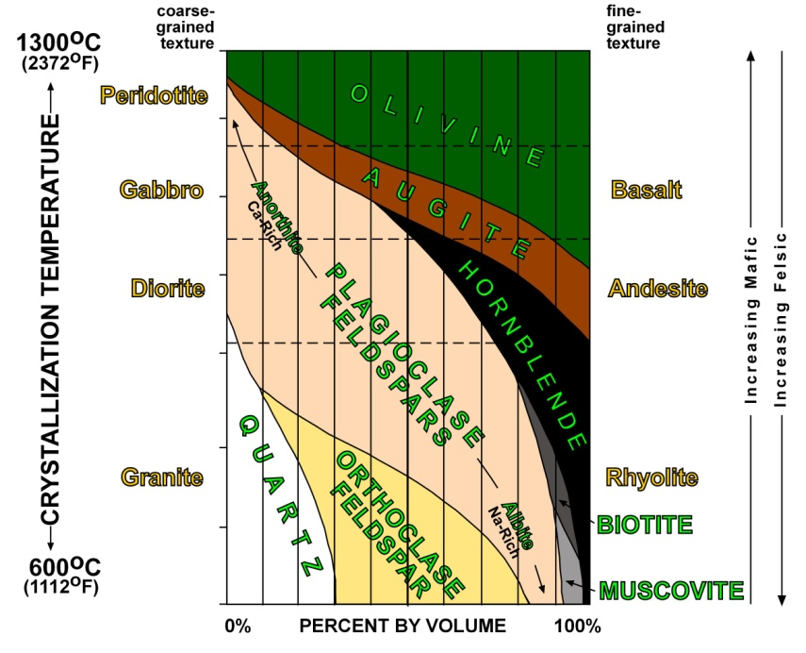
Figure 26 and 27

Slide 26
Figure28

Slide 27
Figure 29

Slide 28
Figure 30

Slide 29
Figure 31

