Slide 1
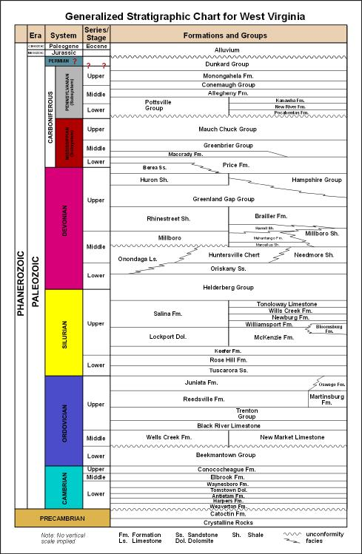
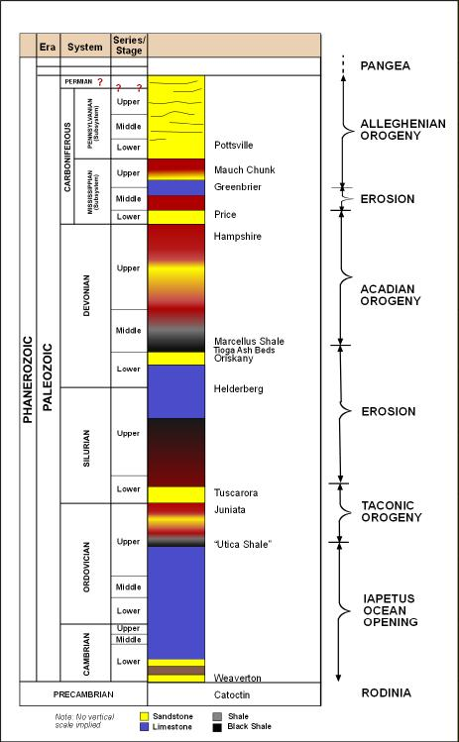
Classroom Friendly
West Virginia Geologic Column
This is the official WVGES geologic column found on the Survey’s main web page at http://www.wvgs.wvnet.edu/www/geology/GenStratChartWV.pdf
This West Virginia Geologic Column is purposely simplified and modified to encourage classroom use. Note the addition of major tectonic orogenies (mountain building episodes).
Each uplift event exposed new source rock to weathering and erosion. The sediment produced by these cyclic processes, when lithified, became West Virginia’s Paleozoic sedimentary rocks. Names of some of the more well known units are provided.

