Slide 1
Faults and Folds

Slide 2
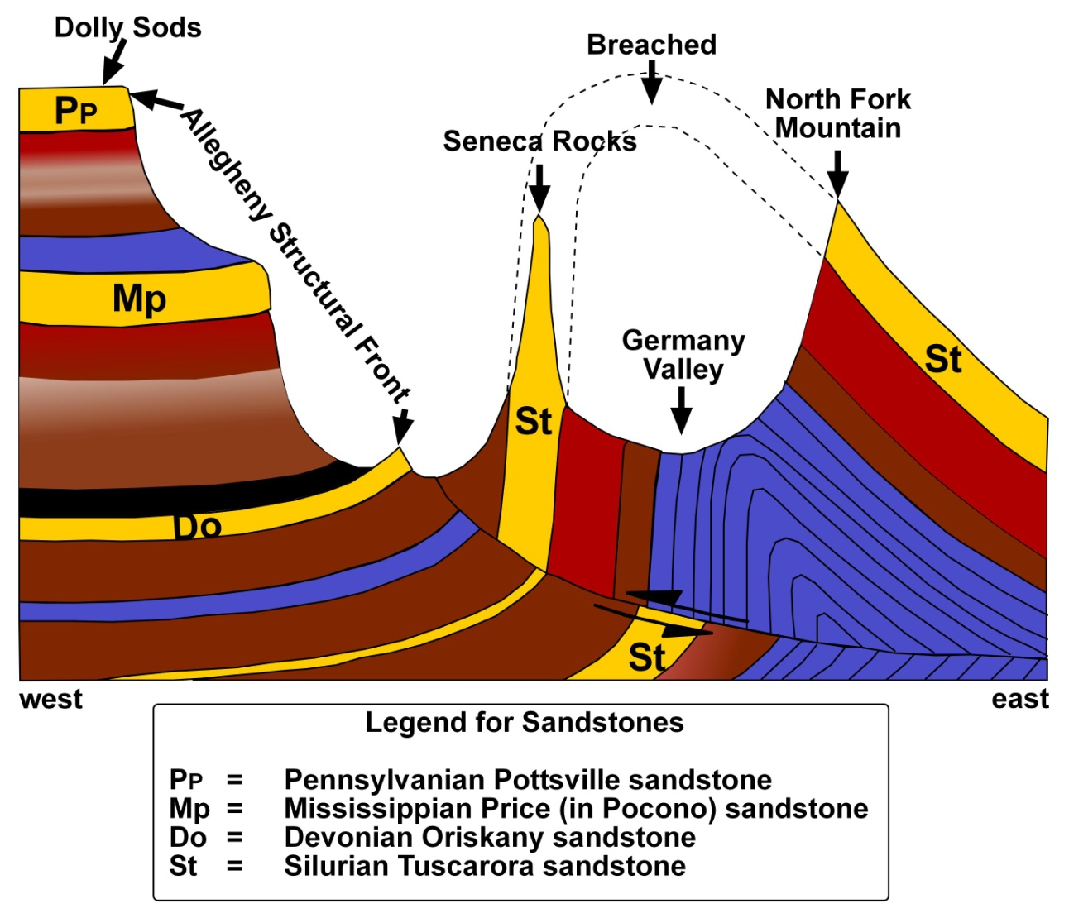
The illustration shows an east-west cross section between the Allegheny Structural Front and North Fork Mountain. The topographic feature called Germany Valley sits atop the geologic structure called the Wills Mountain Anticline. Westward directed compressive forces associated with the Alleghenian Orogeny created the asymmetric to overturned folds as the rocks were simultaneously being pushed westward along a low-angle thrust fault. More recent weathering and erosion has breached the top of the anticline, allowing weathering and erosion to remove less resistant rock. The process has exposed the near vertically-bedded rocks of topographic features we now call Seneca Rocks, North Fork Mountain, and the Allegheny Front which are composed of more resistant to weathering units, such as the Tuscarora sandstone, (St), the Oriskany sandstone (Do), and the Price Sandstone (or Pocono on some older maps, Mp,). Collectively, the more flat-laying layers of Pottsville sandstones (Pp) preserve the topographic feature we call the Allegheny Structural Front. A quick look at the big picture shown in this cross section should include the notion that all rocks were present at one time, that the fault zone extended upward along the Front, and the difference between the relatively flat laying rocks of the Appalchian Plateau and the more intensely folded and faulted rocks of the Valley and Ridge Province.

Slide 3
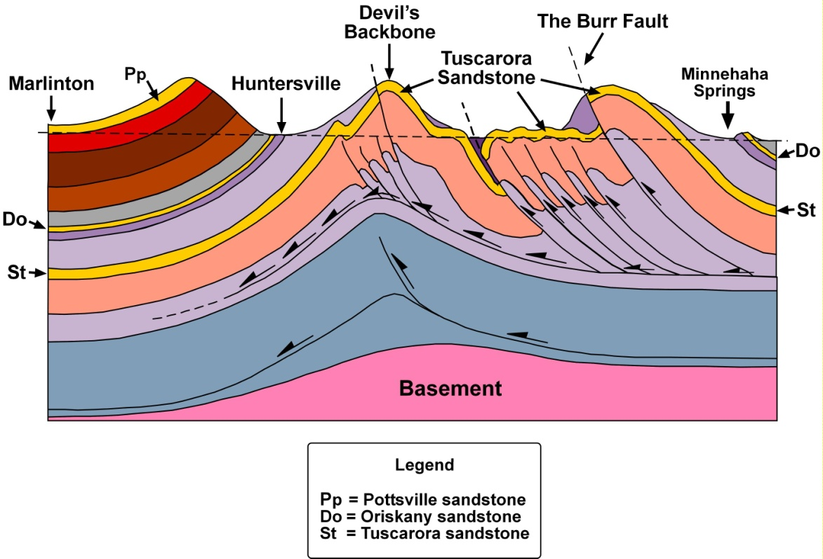
The complex Brown’s Mountain Anticline along an east-west cross section from Minnehaha Springs to Marlinton in Pocahontas County is shown. This drawing illustrates the geologic effect of regional plate tectonic faulting along a very deeply buried low-angle decollement (a very large regional fault) in rock units composed of soft shale or even salt. Some of the compressive tectonic energy was relieved by the creation of high-angle splay thrust faults that shoot up from the decollements to form anticlines such as those that created the geologic structure of the topographic ridge known as Devil’s Backbone. In places, some of the faults break through to the surface and can be visibly mapped. Erosion along the fractured axis of the structure eventually exposed the older rocks that were brought to the surface by the splay faults. In the case of Brown’s Mountain, the rock unit responsible for most of the topographic features within the breached axis of the overall structure is the Silurian Tuscarora sandstone (St).
Note how careful geologic field work would be necessary to compensate for the repeated occurrence of some rock units.

Slide 4
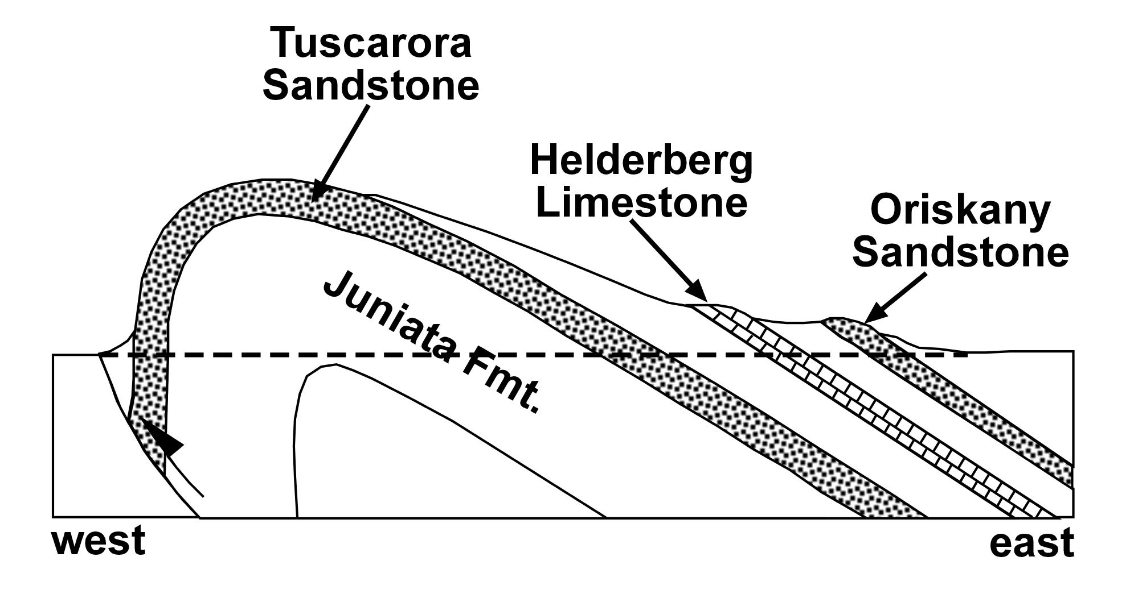
The figure demonstrates how the combined processes of folding and weathering and erosion can produce unique landscapes. This very simplistic cartoon of the Wills Mountain Anticline shows the overall asymmetric nature of the fold. Topographic ridges are formed as the more resistant Tuscarora sandstone and Oriskany Sandstone are exposed by weathering and erosion. In such structures, resistant rocks on the more gently-dipping limb of the structure form monoclinal topographic ridges called hogbacks. A good example of this is the illustrated nature of the Oriskany sandstone.

Slide 5
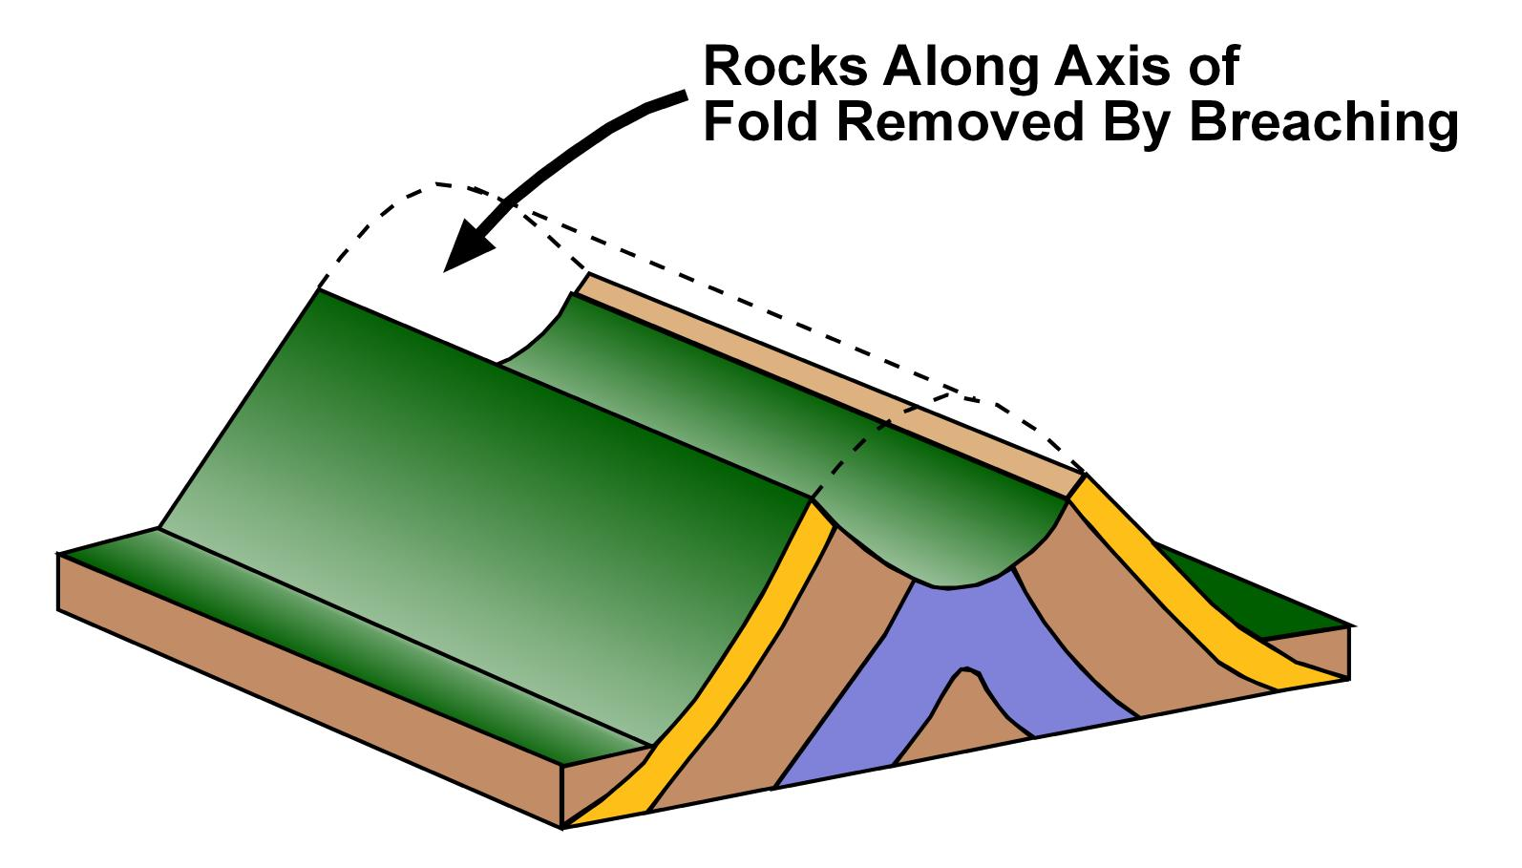
Anticlinal folds are usually “held up” by a resistant cap rock, most commonly a resistant sandstone. Imagine breaking a stick. Compressive forces create the fold (your hands bending the stick) while tensional forces perpendicular generate fractures along the axis of the fold (the top of the stick). These fractures provide pathways for water and the atmosphere to penetrate into the rocks, resulting in a combination of both physical and chemical weathering. Once the fold’s resistant cap rock is penetrated, exposing softer and less resistant rocks such as shales and limestones, the top part of the anticline is gone. The result is a breeched anticline. Once breached, the softer rocks within the core of the structure experience increased rates of weathering. Eventually a topographic valley forms between a pair of monoclinal ridges held up by the remaining more resistant to weathering sandstones.

Slide 6
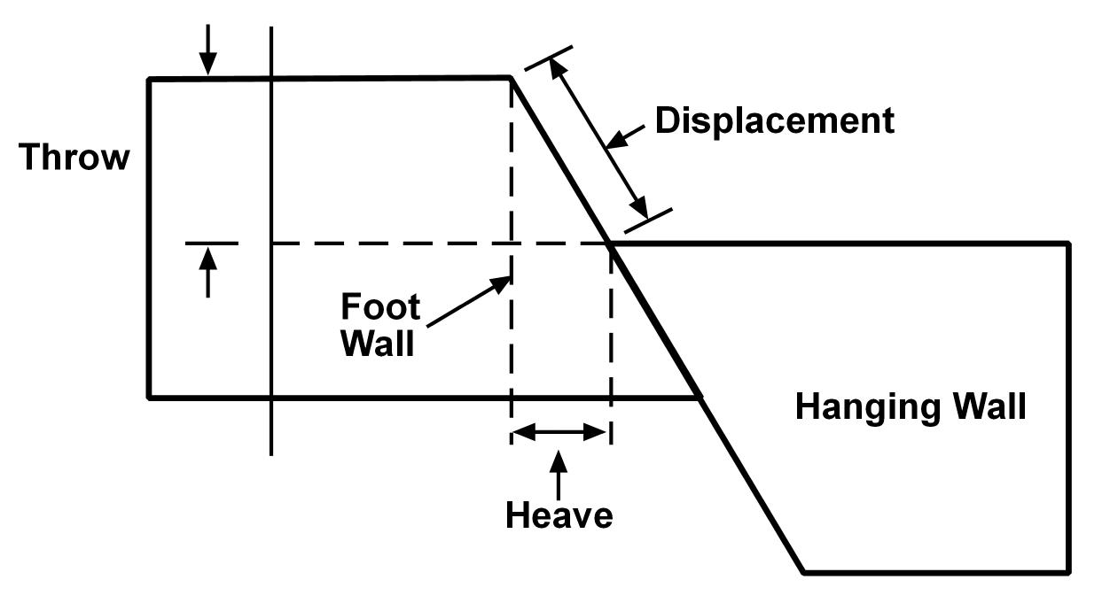
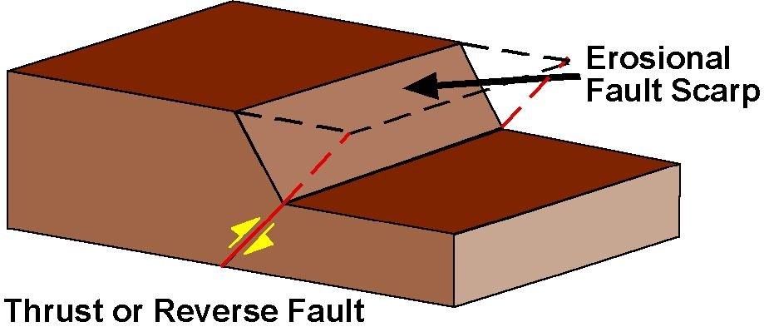
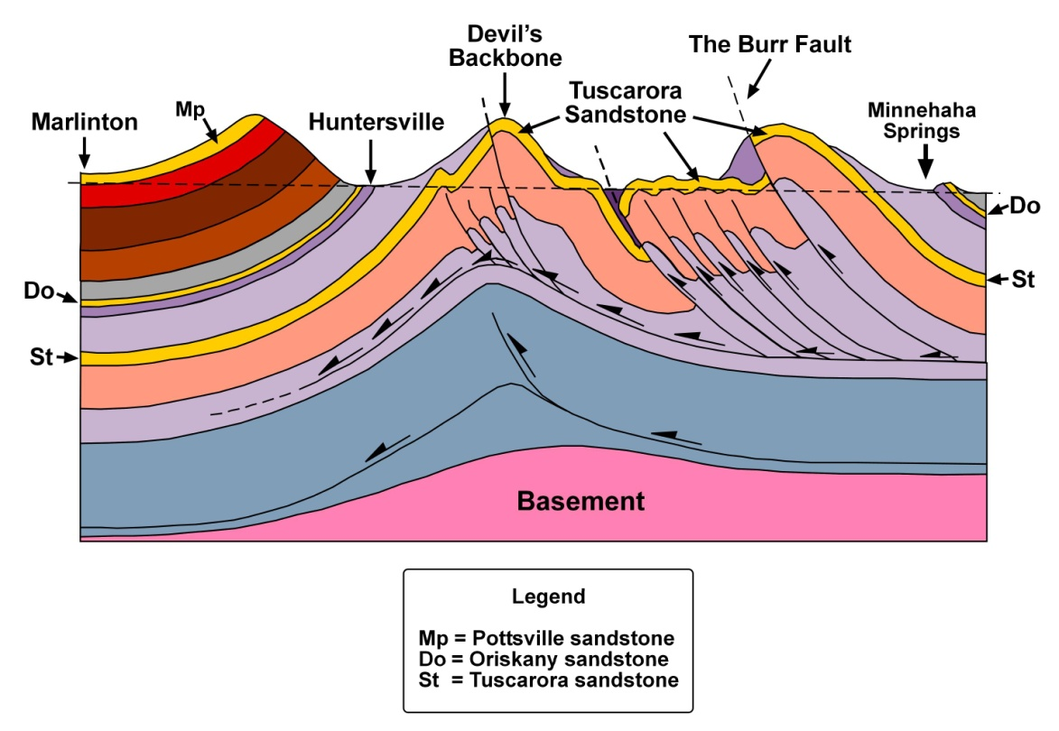
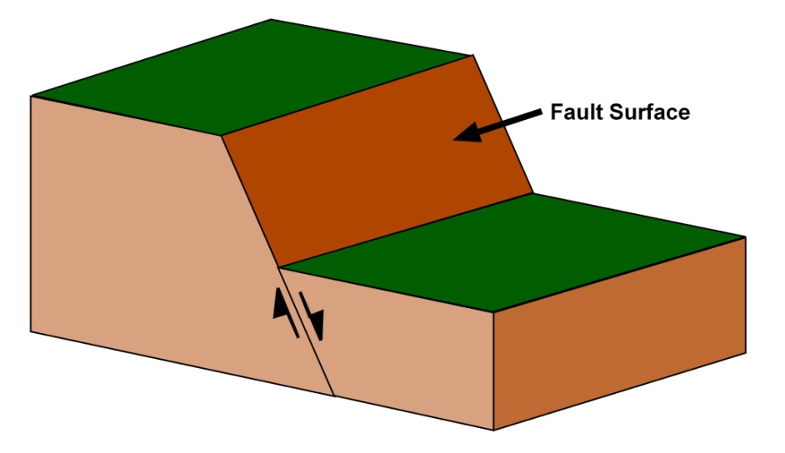
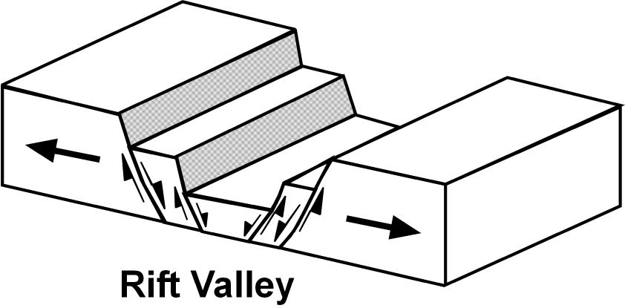
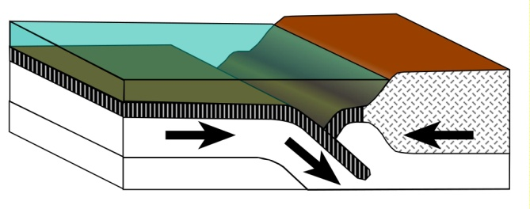
Faults are vertical or horizontal breaks along which there has been movement. Rocks on opposite sides of the fault plane are walls. The hanging wall is the one above the fault and the foot wall is below the fault. Displacement is the actual movement along a fault and can be resolved into horizontal heave and vertical throw. Not all faults are exposed at the surface. The presence of some is only know from earthquakes or shallow seismic exploration.
Normal faults (left) are formed as the Earth’s crust breaks under tensional forces. Under tension, the dominate movement is expansion. Since the fault plane of most normal faults is 45º or greater, the displacement distance is usually greater than the throw or heave distances. The exposed portion of the foot wall is the fault scarp. Once exposed, it will be modified by weathering. At the regional scale, normal faulting is responsible for the formation of rift valleys and basin and range topography.
Thrust faults form under compressive forces and can break the steeper limb of asymmetric or overturned folds. As movement progresses, the leading edge of the rising hanging wall, subjected to constant weathering, is sculpted back to an erosional fault scarp that looks like that of an exposed normal fault. Extensive field work is often required to positively identify thrust faults. The most prominent thrust faults on Earth are those associated with subduction zones that form at the convergent plate margins.

Slide 7
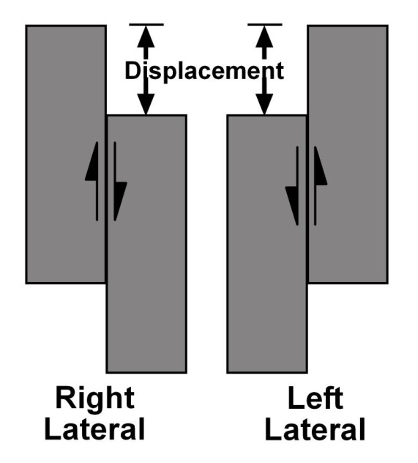
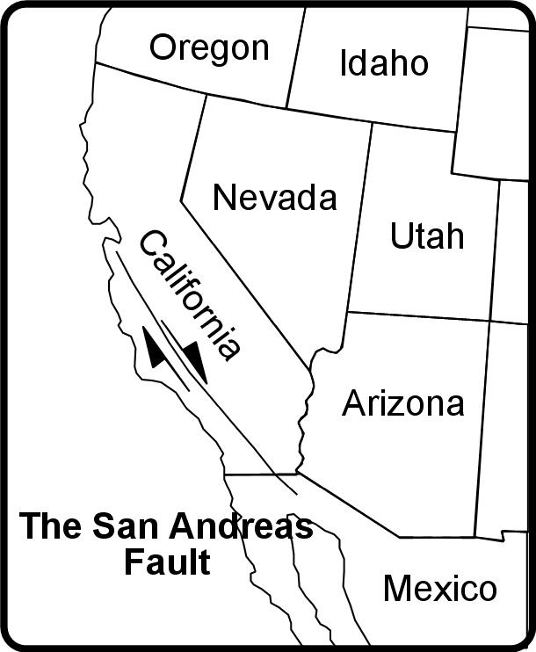
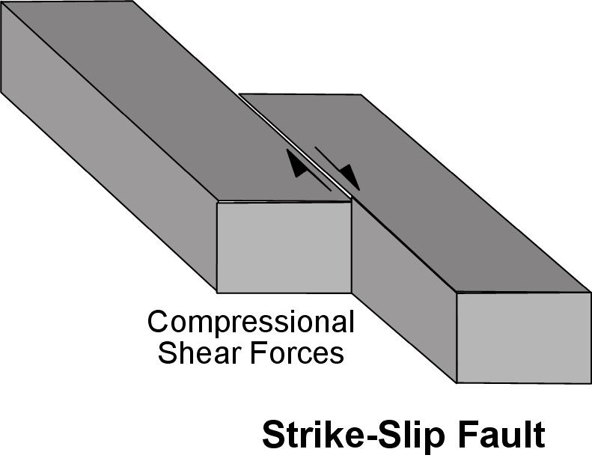
Strike-slip faults are vertical to near vertical faults that form as a result of the application of rotational compression, commonly referred to as shear. In rotational compression, the forces act toward each other but along separate, parallel paths. In strike-slip movement, the displacement is horizontal. There is no equivalent heave or throw displacement, there is no vertical displacement, and without vertical movement, there are no equivalents to the walls described for the normal and thrust faults. The rotational compressive forces can be applied in two modes, producing either a right-lateral or a left-lateral movement. In the right-lateral movement, as one views the fault in a direction perpendicular to the fault, the rock on the opposite side of the fault has moved to the right relative to the observer while the opposite is true of the left-lateral movement. The most well known example of a right-lateral strike slip fault in the United States is the San Andreas Fault.

Slide 8
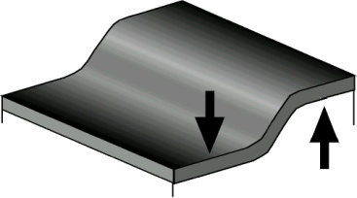
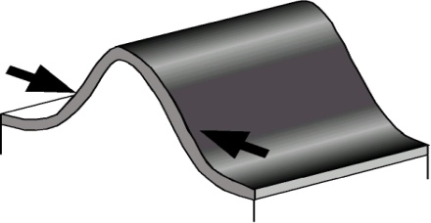
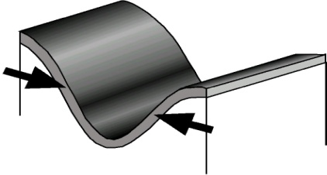
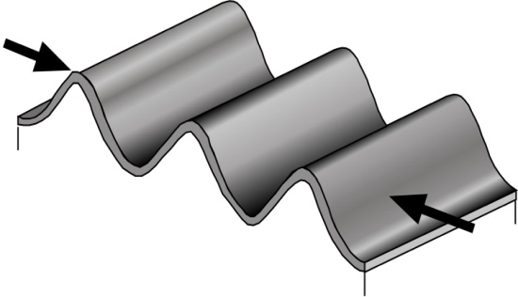
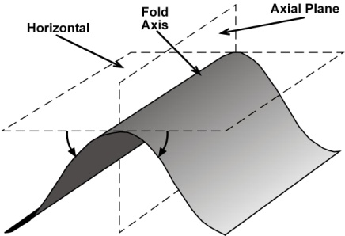
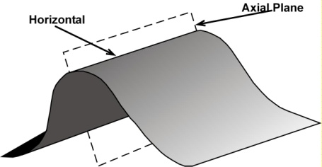
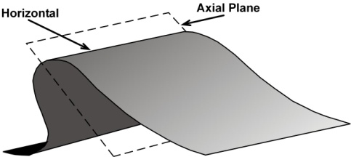
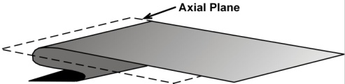
There are three basic types of folds formed by compressive forces: monoclines, anticlines, and synclines. A monocline (a) is defined as a local steepening in an otherwise uniform, gentle slope. Monoclines commonly form along the margins of large uplifts. It is important to remember, and mentally envision, that because all folding takes place at depth and is associated with plate tectonic forces, anticlines (a) and synclines (b) usually occur in association with each other (d). Folds are described based on their axial plane (e) and the attitude of their limbs. A symmetrical anticline (e) has a vertical axial plane running the length of the fold with limbs that dip away from the axial plane at equal angles. In an asymmetric anticline (f), the axial plane dips back in the direction from which the compressive forces originated with limbs that dip away from the axial plane at different angles. In an overturned anticline (g), the axial plane and the limbs all dip back in the direction of the source of the compressive forces while in a recumbent fold, the axial plane and limbs approach the horizontal (h). The change in shape provides many clues about the duration and intensity of the forces under which they formed.
a.
b.
c.
d.
e.
f.
g.
h.

Slide 9
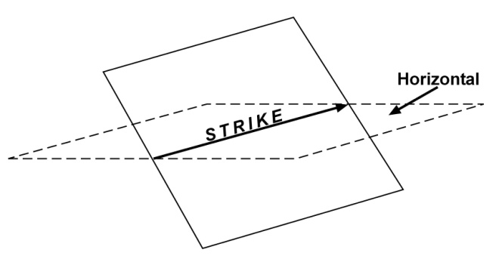
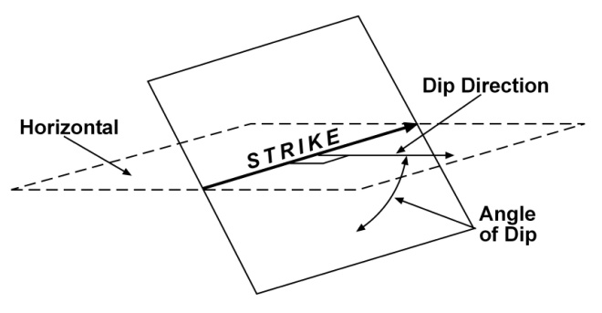
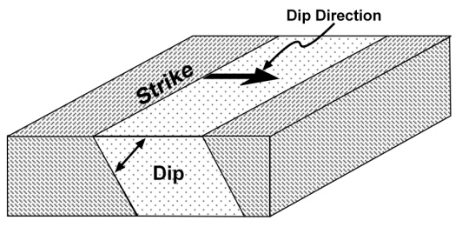
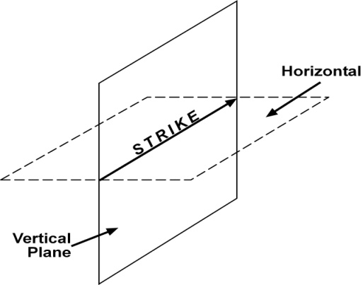
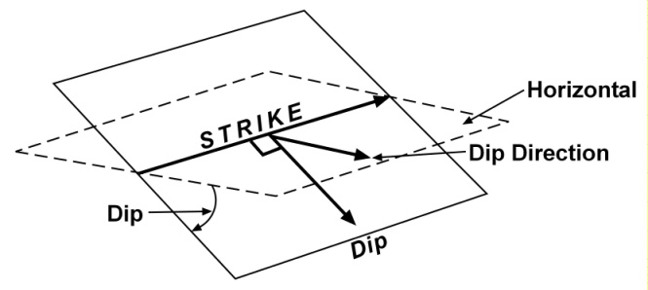
The layered, planar nature of sedimentary rock units provides a way to describe, and map, their spatial orientation. This is done using strike, dip, and dip direction. Strike of a layer of sedimentary rock is the direction of the line of intersection made with the horizontal (a). The direction of strike is usually measured as relative to true north. Dip is the angle between the plane and the horizontal (b). Dip direction is the direction the plane slopes away from the strike when measured perpendicular to the strike. A horizontal surface can not posses any of the three spatial features and is simply described as horizontal. Furthermore, a dip of less than three degrees is very difficult to discern with the naked eye. Since most of the sedimentary rocks in West Virginia’s Plateau have dips of less than five degrees, the statement that most of our sedimentary rocks are flat laying is descriptive but not quite technically accurate. A vertical plane has strike but no dip or dip direction and is simply described as vertical (c). All planes oriented between horizontal and vertical have strike, dip, and dip direction (d). An application of strike, dip, and dip direction is illustrated (e).
a.
b.
e.
c.
d.

